Slide 1
CRIMINAL IDENTIFICATION
By
Tharun P

Slide 2
Abstract
There is an abnormal increase in the crime rate and also the number of criminals are increasing at an alarming rate, this leads toward a great concern about the security issues like various causes of theft, crimes, burglary, kidnapping, etc. are left unsolved.
This project deals with the identification of criminal by getting images using a Robot to identify criminals and provide protection to the victims.

Slide 3
Introduction
To Identify the criminals after the crime, with help of technology we have proposed a project called criminal identification.
In this with the help of the facial recognition multiple images are scanned randomly in public and it compares them with the images which have already stored in database.
Haar cascading algorithm is used for face recognition. Gait analysis is used to detect human motion and to identify humans on different pattern recognition.
Firstly it takes the human face as an input and next the face tracking process starts where it track the human faces frame by frame.
Later by comparing in database it conforms the criminal and gets all records of that criminal, so by these steps it helps us to find criminals

Slide 4
Literature Survey
Paper 1
A Robotic System for Crime Detection using Gait Analysis
- Rochanaa Shri M, Sruthi V, R. L. Nithuna, Suppriya V. N
Gait Analysis is a Biometric technique used to identify humans based on pattern recognition. This project proposes the use of Gait, not only as a biometric system but also for identifying threatening activities. This system proves to be useful and cost-effective because of its effectiveness and the use of IOT and Cloud to ease the use of Gait Databases from anywhere. This project deals with the CRIME DETECTION using a Robot to identify criminal activities and provide protection to the victims.

Slide 5
Paper 2
Automated Criminal Identification System using Face Detection and Recognition
- Piyush Chhoriya
Face recognition is a personal identification system that uses personal characteristics of a person to identify the person's identity. Human face recognition procedure basically consists of two phases, namely face detection, where this process takes place very rapidly in humans, except under conditions where the object is located at a short distance away, the next is the introduction, which recognize a face as individuals. The software requirements for this project is matlab software.

Slide 6
Paper 3
Criminal Identification by Using Real Time Image Processing
- Tiwari Aanchaladevi S, Ghotekar Shubhangi S,
Ghotekar Ashwini S, Manjare Mayuri A, Prof. Bankar A.A
The main goal of this paper is to help in real time for face recognition by using automated face surveillance camera. The proposed system has of 4 steps, it include training of real time images, face detection using Haar based classifier, comparison of trained real time images with images from the surveillance, camera result based on the comparison between them

Slide 7
System Analysis
Existing System
Proposed System
Criminal record generally contains personal information about particular person along with photograph. To identify any criminal we need some identification regarding person, which are given by eye witnesses. Based on the details given by eyewitnesses, the criminal who did the crime will be identified manually.
Feature extraction domain has plenty of collection of generalized face features from several images of the same subject. Then, each face image is processed, features are extracted and the collection of features are analyzed and combined into a single generalized features collection, which is written to the database. The face is our primary focus of attention in social inter course playing a major role in conveying identification

Slide 8
System Requirement Specifications
Hardware Requirement
Software Requirement
Dual core processor and Higher version.
RAM 1GB and Above.
20GB of hard disk space in terminal
machines
Windows 7 or above operating system .
MATLAB (Matrix Software).
Aurdino Supporting IDE’s.
Database.

Slide 9
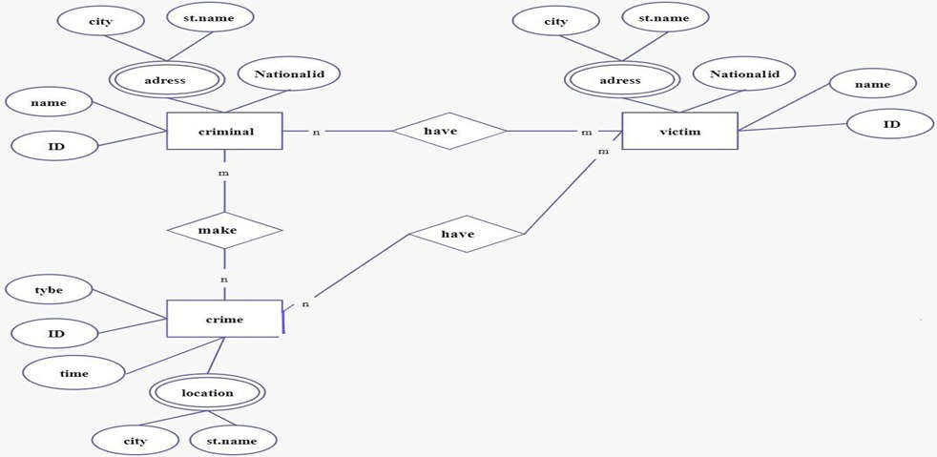
System Design
ER Diagram

Slide 10
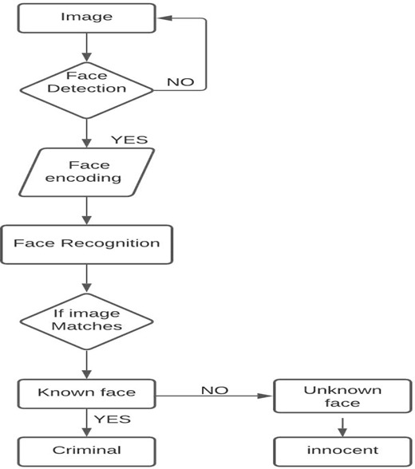
Data Flow Diagram

Slide 11
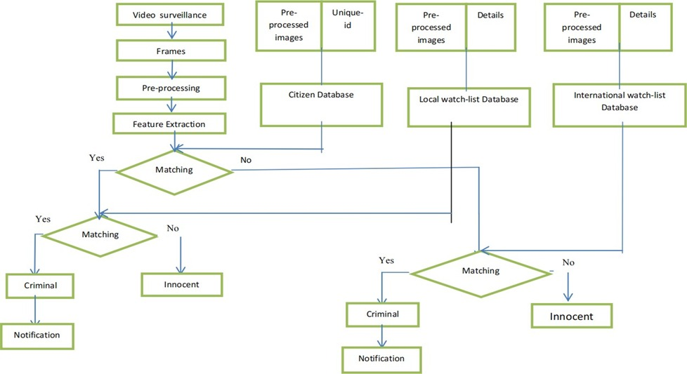
Flow Chart

Slide 12
Implementation
The proposed system is to detect criminals in public places with the help of Robots.
The system does facial recognition for covered (by Mask or scarf) and uncovered faces.
With the help of Python language and OpenCV the system software will be developed.
Along with the above one, we use Haar cascading Algorithm and Gait Analysis for detecting Humans and their motions.

Slide 13
Thank You

